Slide 1
Final Project
Katie Silver, Zoe Howard-Barr, Arin Nelson, Tom Zhang

Slide 2
Research Question 1 Introduction
Table bookings have increased in popularity, as more restaurants offer this option through a number of online reservation apps as well as calling the restaurant. Using the Zomato Restaurants dataset, our research focuses on restaurant rating text in the context of the table booking opportunity.

Slide 3
Research Question 1
Is there an association between the option to book a table reservation and restaurant rating text (commentary)?
Rationale: Research indicates that the ability to book a table at a restaurant can influence a person’s feelings about their experience prior to entering the restaurant through leaving after the meal (Alex Alexandrov, Martin Lariviere. 2007). The ability to book a reservation may influence a person’s decision to give a more positive or negative rating text.

Slide 4
Research Question 1 Hypothesis
Null: There is not a significant association between whether the restaurant offers table bookings and restaurant rating text.
Alternative: There is a significant association between whether the restaurant offers table bookings and restaurant rating text.
Rationale: Research indicates that restaurants who take table bookings are able to provide better and faster service because the restaurant and its staff can prepare for the number of people that will be present at a given time (Alex Alexandrov, Martin Lariviere. 2007). Similarly, we expect people who have the ability to book table reservations will be more likely to give the restaurant a more positive rating text.

Slide 5
Variables
Variable Name | Variable Type | Response/Explanatory | Variable Description
Has.Table.booking | Categorical (dichotomous) | Response | Does the restaurant have tables available for booking? No Yes
Rating text | Categorical | Explanatory | Text on the basis of rating Excellent Very Good Good Average Poor

Slide 6
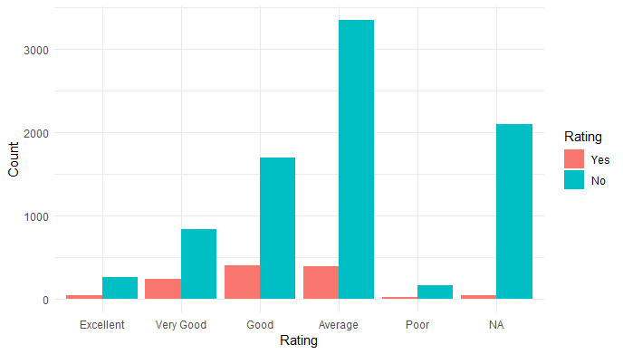

Plot

Slide 7
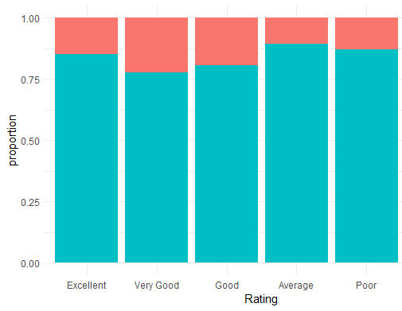
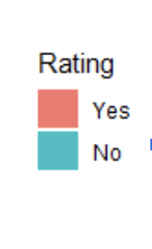
Plot

Slide 8
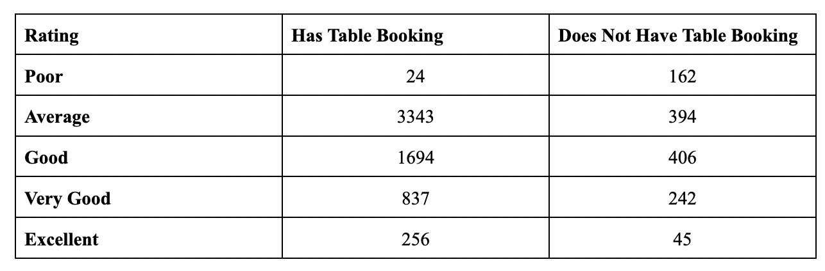
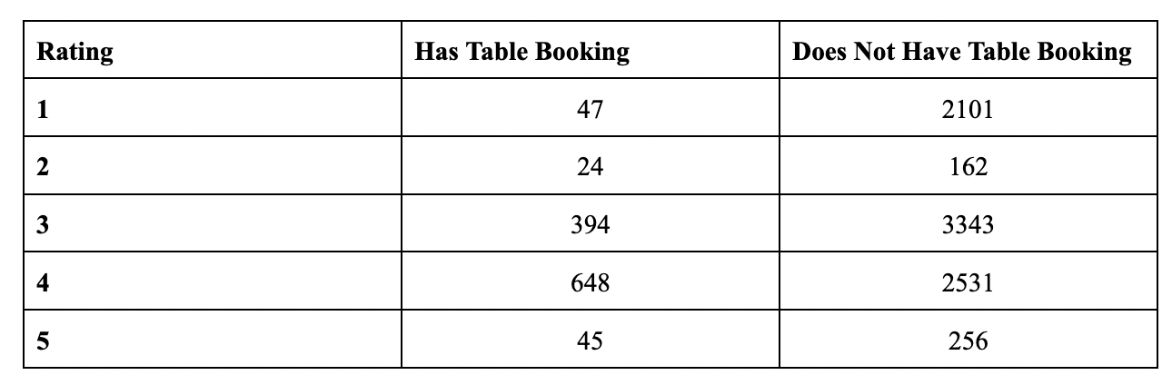
Chi Squared Test Assumptions
All expected cell counts are > 5, so chi squared test assumptions are met.

Slide 9
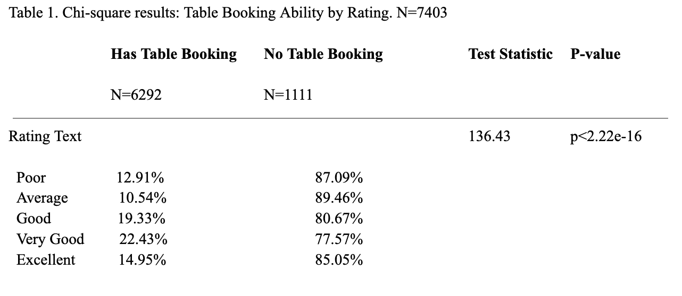
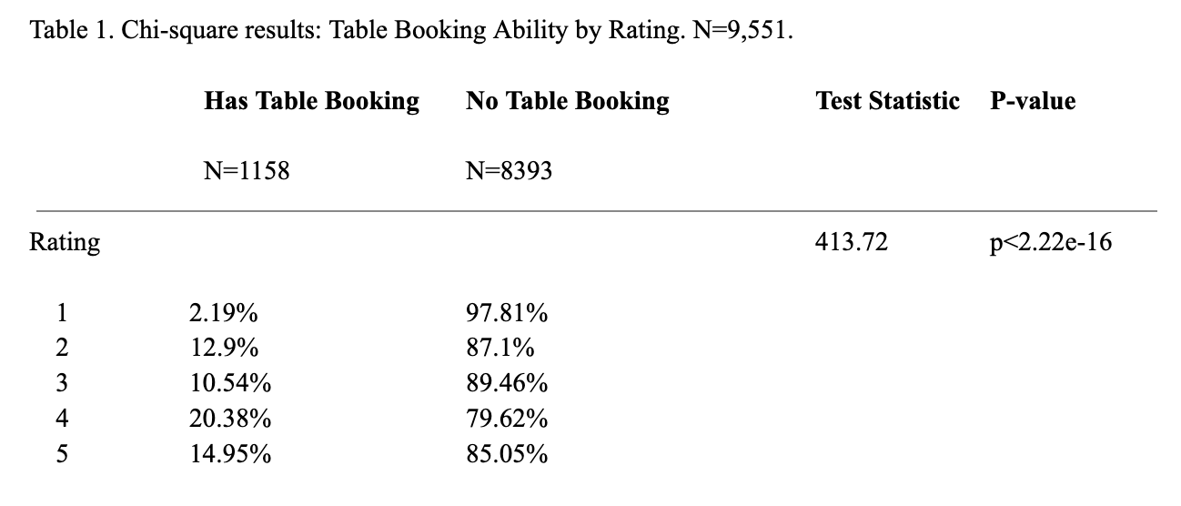
Statistical Analysis: Chi Squared Test

Slide 10
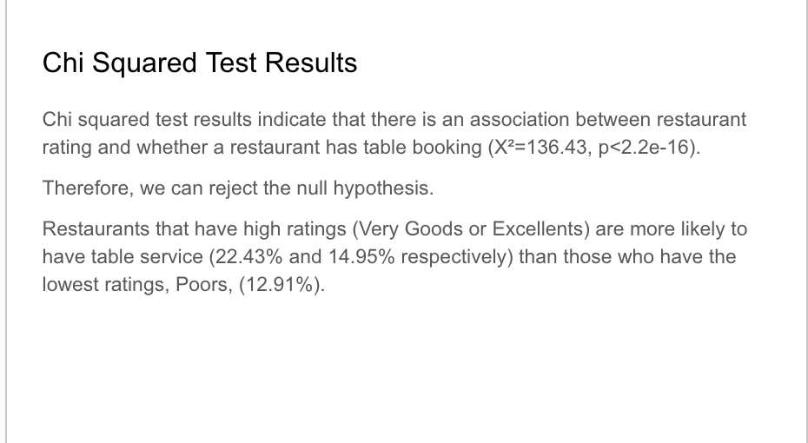
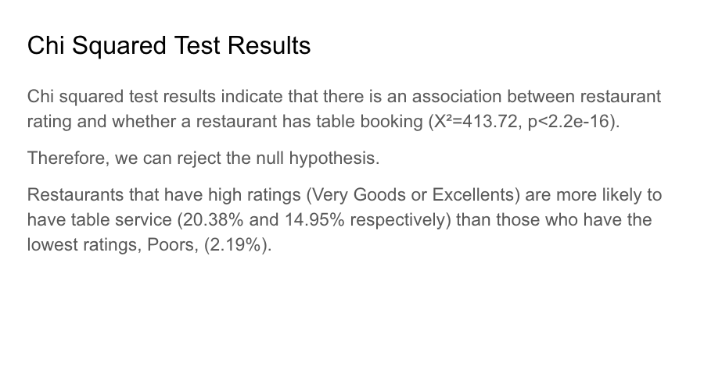
Chi Squared Test Results

Slide 11
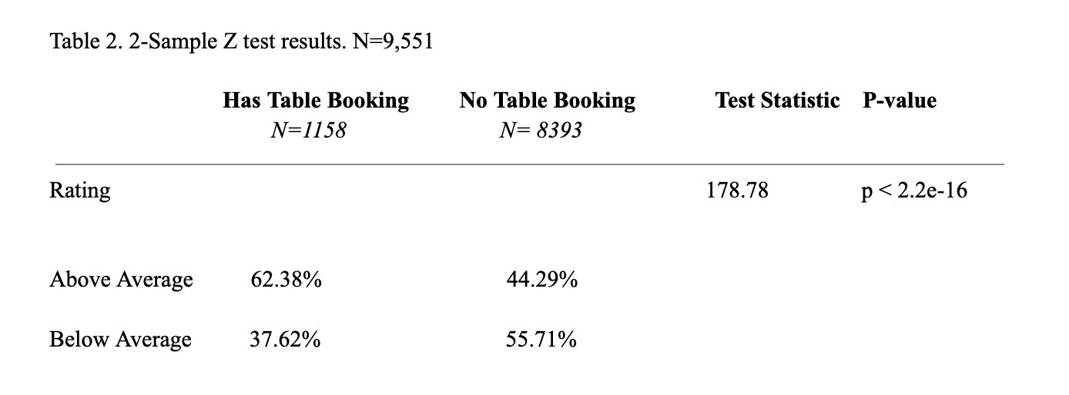
Z-Test Results

Slide 12
Z-Test Statistical Analysis:
These results indicate that there is a association between restaurant rating and whether a restaurant has a table booking.(χ2 =178.78, P < 2.2e -16)
Therefore, we can reject the null hypothesis.
Restaurants who have above average service are more likely to have table bookings (62.38%) than those who have below average service (37.62%).

Slide 13
Discussion
Across both tests we find restaurants that have higher ratings are more likely to have table booking options. This indicates that perhaps one factor that influences restaurant rating may be table booking. However, a majority of restaurants that have high ratings do not have table bookings. This may be due to other factors like locality, price range, or cuisine quality.
Further research could be done into other factors that influence restaurant rating or why the majority of restaurants choose not to have table booking services.
Because we rejected our null hypothesis, a Type I error is possible. We satisfied assumptions for inference, but a Type I error would mean that there is no association between restaurant rating and the option of table booking.

Slide 14
Research Question 2 Introduction
A person’s opinion of their restaurant experience is intertwined with a number of factors, such as pricing. Restaurants greatly vary in pricing, from cheap fast food meals to expensive high dining meals. Using the Zomato Restaurants dataset, our research focuses on restaurant aggregate rating in the context of price range.

Slide 15
Research Question 2
Is there an association between the price range and restaurant rating?
Rationale: Research indicates that there may be a relationship between a customer’s perception of their restaurant experience– enjoyable or not– and the price they paid for the meal (Roger Montti. 2021). A restaurant’s aggregate rating may be reflective of its menu pricing.

Slide 16
Research Question 2 Hypothesis
Null: There is not a significant association between price range and restaurant rating.
Alternative: There is a significant association between price range and restaurant rating.
Rationale: Research indicates a positive relationship between an increase in restaurant pricing and higher ratings, suggesting that restaurants with higher menu pricing receive higher customer ratings (Chuck Finder. 2021). Similarly, we expect that restaurants in the dataset with with higher pricing will have higher aggregate ratings.

Slide 17
Variables
Variable Name | Variable Type | Response/Explanatory | Variable Description
Price range | Categorical | Explanatory | Range of food price 1 2 3 4
Aggregate rating (recoded to “rating2”) | Numerical | Response | What is the average rating of the restaurant 1 2 3 4 5

Slide 18
Recoding Procedures
Aggregate rating
Original categories: continuous 0.0-5.0
New categories of rating: discrete
1
2
3
4
5
Rationale: Collapsed the 1 category due to the category not meeting chi-squared test assumptions of populating 5 or more values. Same as for research question 1.

Slide 19
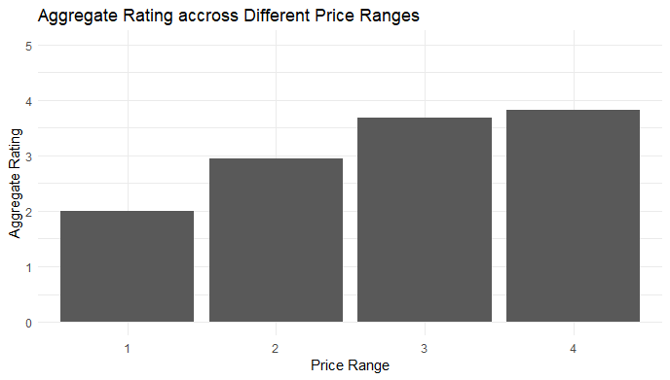
Bar Plot

Slide 20
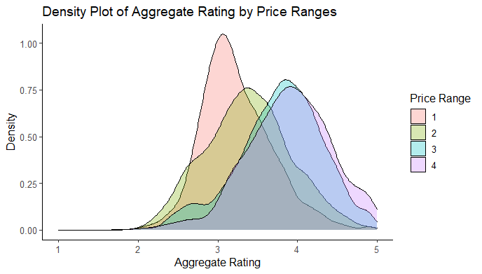
Distribution Plot

Slide 21
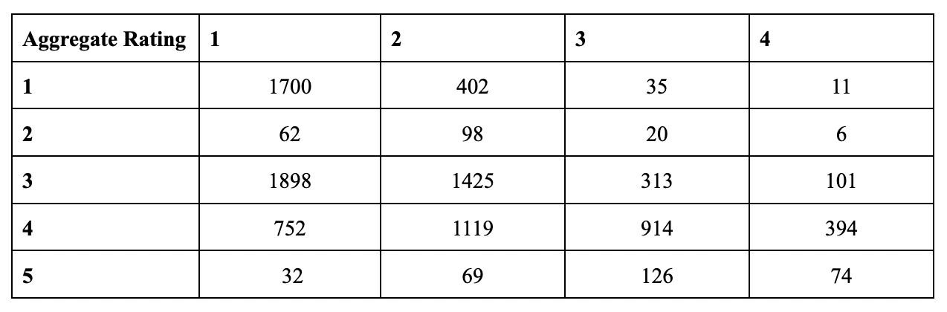
Chi Squared Test Assumptions
All expected cell counts are > 5, so chi squared test assumptions are met.

Slide 22
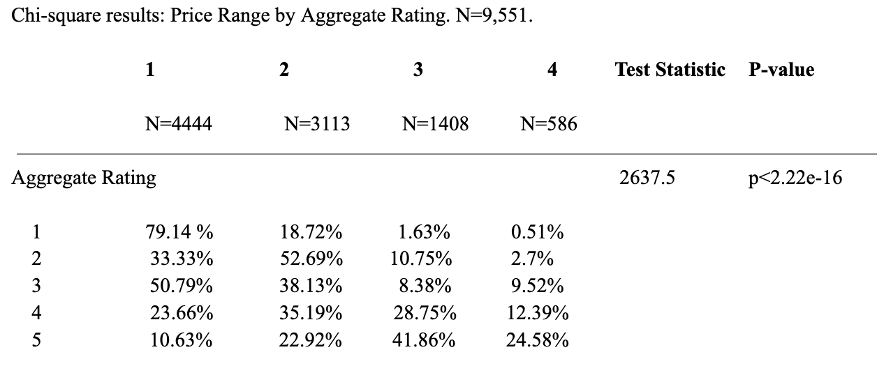
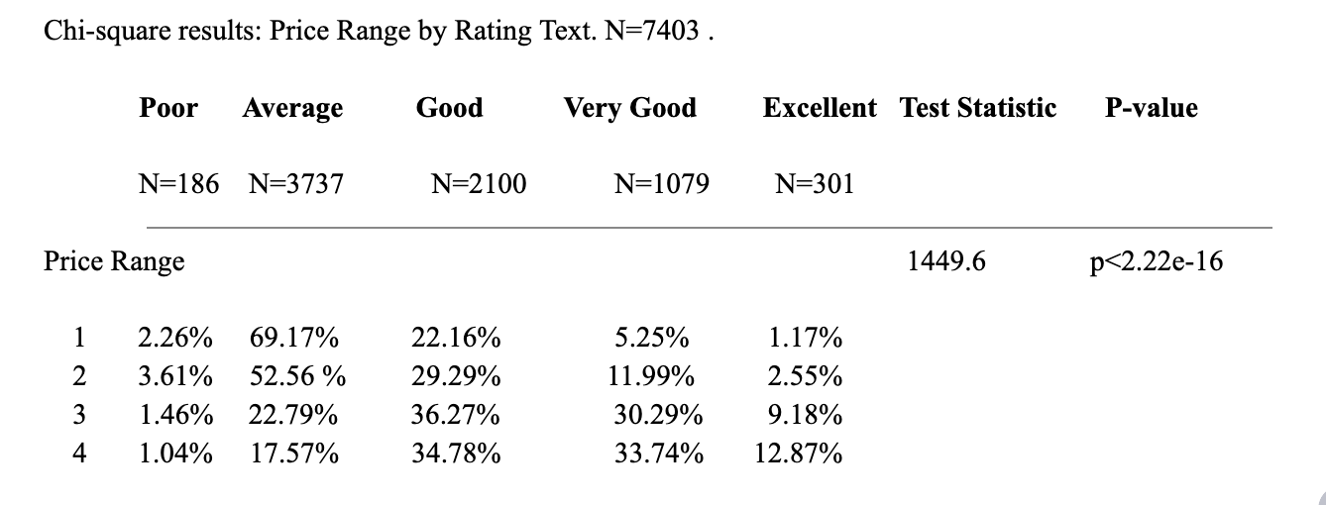
Statistical Analysis: Chi Squared Test

Slide 23
Chi Squared Test Results
Chi squared test results indicate that there is an association between restaurant rating and a restaurant’s price range (X²=2637.5, p<2.2e-16).
Therefore, we can reject the null hypothesis.
Restaurants that have higher price ranges (3s or 4s) are more likely to have 5 ratings (41.86% and 24.58% respectively). Restaurants with lower price ranges (1s) are less likely to have 5 ratings (10.63%).

Slide 24
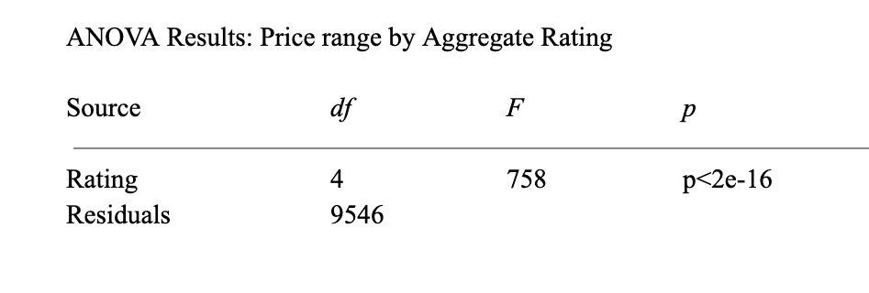
Statistical Analysis: ANOVA

Slide 25
ANOVA Results
The ANOVA test results indicate that the mean price range of a restaurant is not equal across all rating categories (F=758, p<2e-16).
Therefore, we can reject our null hypothesis and conclude that there is an association between price range and a restaurant’s aggregate rating.

Slide 26
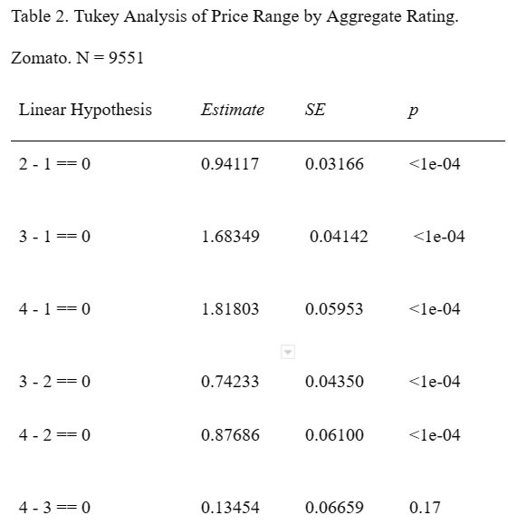
Statistical Analysis: Tukey Test

Slide 27
Tukey Test
Because the ANOVA test produced significant results, we can conduct a Tukey test to see pairwise comparisons of variables.
All pairwise comparisons produced p-values that were below 0.05 except for price ranges of 3 and 4, allowing us to reject the null hypothesis that any two compared categories except of price range of 3 and 4 have equal means.

Slide 28
Discussion
Across both tests we find restaurants that have higher ratings are more likely to have higher price ranges. This indicates that perhaps one factor that influences restaurant rating may be the price range of that restaurant. However, restaurants that have high ratings do not all have high price ranges. This may mean rating is due to a mix of other factors like location, cuisine type, publicity, etc. .
Further research could be done into other factors that influence restaurant rating or why some restaurants with low price ranges are able to achieve high ratings.
Because we rejected our null hypothesis, a Type I error is possible. We satisfied assumptions for inference, but a Type I error would mean that there is no association between restaurant rating and price range.

Slide 29
Research Question 3 Introduction
Many people, after visiting a restaurant, turn to online platforms such as
Google review and Yelp to rate their experience. The number of responses vary
from restaurant to restaurant, with some having few votes while others have much
more. Using the Zomato Restaurants dataset, our research focuses on restaurant
ratings in the context of the number of votes a restaurant receives.

Slide 30
Research Question 3
Is there an association between the number of votes cast and restaurant rating?
Rationale: Research indicates that a person’s restaurant experience, whether it be negative or positive, influences their desire to vote on a restaurants page (Christen. 2022). The total number of votes a restaurant receives may influence the restaurant’s average rating.

Slide 31
Research Question 3 Hypothesis
Null: There is not a significant association between the number of votes a restaurant receives and restaurant rating.
Alternative: There is a significant association between the number of votes a restaurant receives and restaurant rating.
Rationale: Research indicates that restaurants with more votes tend to have higher ratings, as greater amounts of responses control for poor rating outliers (Philippe Masset, Jean-Philippe Weisskopf). Similarly, we expect that restaurants with a higher number of votes will also have higher ratings.

Slide 32
Variables
Variable Name | Variable Type | Response/Explanatory | Variable Description
Votes | Numerical | Explanatory | Number of ratings casted by people 0-10934
Aggregate rating (recoded to “rating2”) | Numerical (recoded to discrete) | Response | What is the average rating of the restaurant 1 2 3 4 5

Slide 33
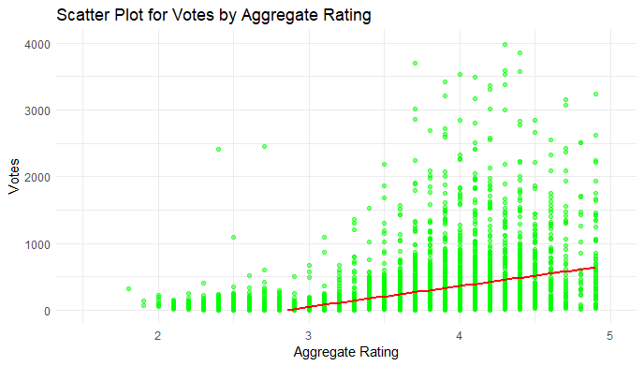
Plot

Slide 34
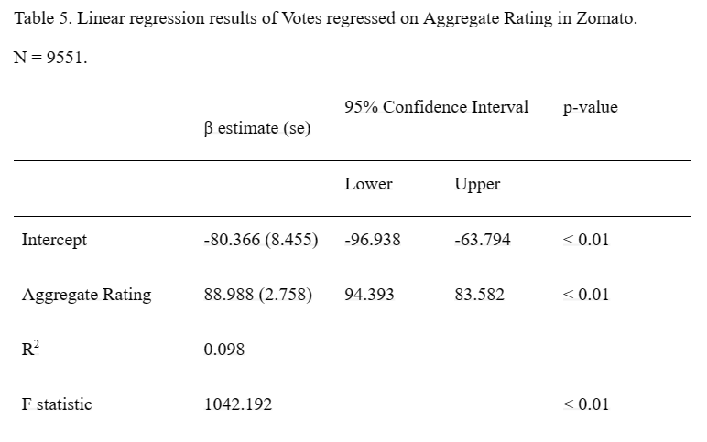
Linear Regression

Slide 35
Linear Regression Results
The results indicate that there is a statistically significant positive relationship between aggregate rating and Votes. The regression coefficient for Aggregate.rating is 88.988, which is statistically significant at the 0.01 level.
The intercept is also significant at the 0.01 level, suggesting expected -80.366 votes for a rating of zero. However, this can be unrealistic because we cannot get a negative number of votes.
The R-squared value for the model is 0.098, which means that 9.8% of the variation in Votes is explained by the Aggregate rating variable. The low value of R-squared suggests that a linear regression with a single variable of aggregate rating may not fully explain the votes variable.

Slide 36
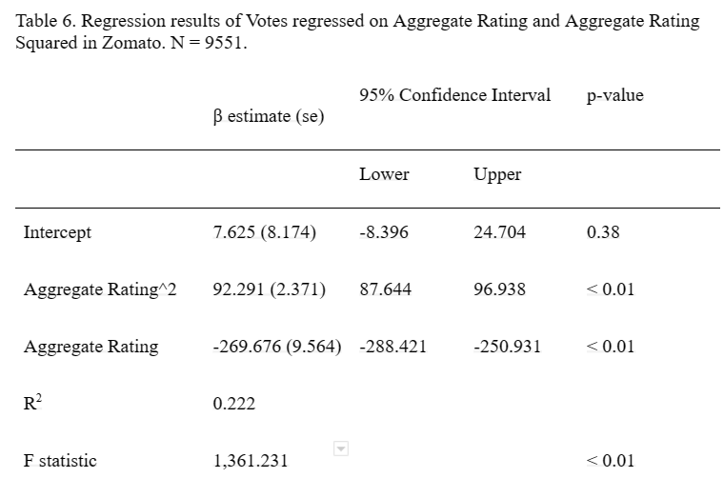
Improved Regression Test

Slide 37
Improved Regression Results
Adding a squared variable of aggregate rating improves both the R-squared score to 0.222 and the F statistic from 1042.192 to 1361.231, and the coefficient for the squared variable is also statistically significant at the 0.01 level.
This means that a squared variable may better explain the relationship between aggregate rating and votes.

Slide 38
Discussion
The results from our linear regression test indicate that there is evidence that the correlation between the number of votes a restaurant receives and its aggregate rating are not equal to zero. This result may indicate that an increase in votes leads to an increase in rating.
This may mean restaurants try to encourage patrons to vote on the restaurant in hopes of increases its overall rating.
Because we rejected our null hypothesis, it is possible that a type 1 error occurred. This would mean that there is no actual correlation between amount of votes and aggregate rating.

Slide 39
Research Question 4 Introduction
Similar to research question 2, a person’s opinion of their restaurant experience is intertwined with a number of factors, including pricing. Restaurants vary in pricing, from cheap fast food meals to expensive high dining meals. Using the Zomato Restaurants dataset, our research focuses on restaurant rating in the context of price range. For this question, we are focusing on comparing inexpensive restaurants to high-priced restaurants.

Slide 40
Research Question 4:
Is there a difference in mean aggregate rating of restaurants with high and low price ratings?
Rationale: Our previous research in question 2 indicated that there is a significant association between price range– when rated 1-4– and a restaurant’s aggregate rating. A restaurant’s aggregate rating may also be reflective of menu pricing when grouped into “low” and “high” pricing.

Slide 41
Research Question 4 Hypothesis
Null: The mean aggregate rating of a restaurant is equal for high and low price rated restaurants.
Alternative: The mean aggregate rating of a restaurant is different for high and low priced restaurants.
Rationale: In our previous research, we suggested that restaurants that have higher price ranges (3s or 4s) are more likely to have 5 ratings while restaurants with lower price ranges (1s or 2s) are less likely to have 5 ratings. Similarly, when we dichotomize the price rating variable to “high” and “low”, we expect the mean aggregate rating of a restaurant to be different for high and low priced restaurants.

Slide 42
Variables
Variable Name | Variable Type | Response/Explanatory | Variable Description
Price range (recoded to Price.range2) | Categorical (recoded to dichotomous) | Explanatory | Range of food price High Low
Aggregate rating (recoded to “rating2”) | Numerical | Response | What is the average rating of the restaurant 1 2 3 4 5

Slide 43
Recoding Procedures
Price Range
Original Categories:
1
2
3
4
For the 2-sample t-test, we recoded the variable to have two categories “high” (3 and 4) and “low” (1 and 2)
Rationale: We did this to satisfy the necessary conditions to run a 2-sample t-test, dichotomizing the variable.

Slide 44
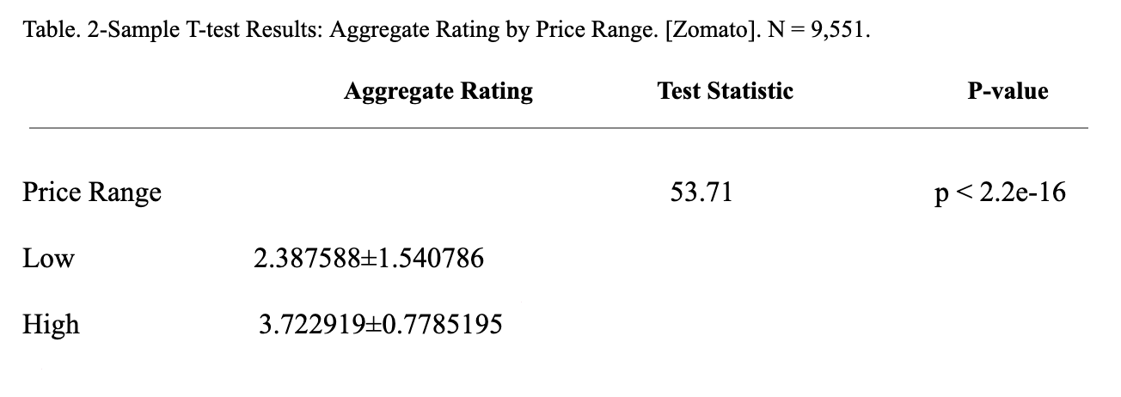
Statistical Analysis: 2 Sample T-Test

Slide 45
Results: 2 Sample T-Test
2-Sample T test results indicate that there is an association between a restaurant’s aggregate rating and the pricing.
Therefore, we can reject the null hypothesis.
Restaurants that have higher price ranges are more likely to have high ratings. (3.722919±0.7785195) Restaurants with lower price ranges are more likely to have low ratings(2.387588±1.540786).

Slide 46
Discussion
In the two-sample t-test, we find that there is a an association between a restaurant’s aggregate rating and the pricing (high or low). Restaurants with high pricing tend to have higher ratings while restaurants with low pricing tend to have lower ratings.
This supports our research in question two, which found a positive association between an increase in restaurant pricing and higher aggregate rating.
Aligning with question 2, further research could be done into other factors that influence restaurant rating or assessing outliers in which low priced restaurants did in fact have a high rating.
Because we rejected our null hypothesis, a Type I error is possible. We satisfied assumptions for inference, but a Type I error– if we rejected the null hypothesis when it is actually true in the population– would mean that there is no association between restaurant aggregate rating and high or low pricing.

Slide 47
Overall Discussion
Our results look at how restaurants are perceived by the public by looking at restaurant price, rating, and the number of votes a restaurant received. We explored how these factors were interconnected and found statistically that there are intrinsic relationships between them.
If we were to re-explore this topic, perhaps a more extensive sample size or more time to delve deeper into the facets of our data set would have allowed us to pull more conclusions. We could have explored cuisine type and location as factors that influence the ways in which a restaurant is regarded. Perhaps it would be possible to statistically discern what makes up a quality restaurant.

Slide 48
Works Cited
Alexandrov, Alexei, and Martin Lariviere. “Are Reservations Recommended?” Kellogg Insight, 10 May 2019,
https://insight.kellogg.northwestern.edu/article/are_reservations_recommended.
Christen. “Importance of Restaurant Online Reviews.” Revolving Kitchen, 31 May 2022,
https://revolvingkitchen.com/2022/04/29/how-important-are-online-restaurant-reviews/#:~:text=Restaurants%20Serve%20More%20Customers%20Than%20Other%20Businesses&text=Many%20customers%20have%20opinions%20about,many%20people%20use%20your%20services.
Finder, Chuck. “Price Is Ripe: Study Finds Increase in Menu Prices Means Decrease in Restaurant Ratings - the Source - Washington University in St. Louis.” The Source, 9 Feb. 2021,
https://source.wustl.edu/2021/01/price-is-ripe-study-finds-increase-in-menu-prices-means-decrease-in-restaurant-ratings/.
Masset, Philippe, and Jean-Philippe Weisskopf. “Online Customer Reviews: Their Impact on Restaurants.” Hospitality News & Business Insights by EHL,
https://hospitalityinsights.ehl.edu/online-customer-reviews-restaurants.
Montti, Roger. “Research Exposes Role of Pricing on User Ratings.” Search Engine Journal, 6 Jan. 2021,
https://www.searchenginejournal.com/how-consumer-ratings-may-be-biased-by-price/391813/.

